Slide 1

Fraud Claim Prediction
Team Name: ProAnalytics (G4)
Mentor Name: Parth Sagar
Project Members Name:
Shrikant Uppin
Gokul Achari
Kunal Kolhe
Gaurav R Sonawane
Veerannagowda patil
Siddhartha Mukherjee
Date: 16-Jan-2021

Slide 2
Business Problem:
Fraud Claim Predictions
Business Objective:
The objective of analysis is to detect fraud insurance claims by hospitals to Insurance Company and do analysis by using Python libraries and eventually build a model to predict Fraud Claims with utmost Accuracy

Slide 3
1) Dataset Details and findings

Slide 4
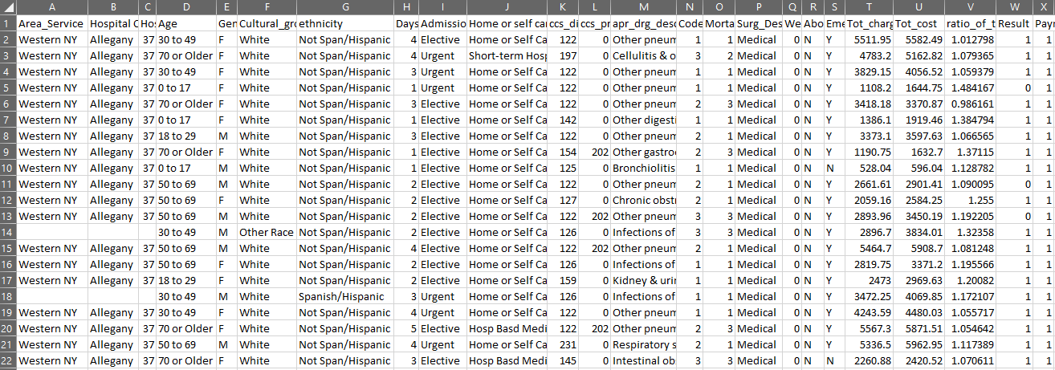
1) Dataset Details
Total number of records : 1048575
Total number of features : 24

Slide 5
1) Dataset Details
Categorical Features
Numeric Features
Feature Name Not-null Datatype
Feature Name Not-null Datatype
Area_Service
Hospital County
Age
Gender
Cultural_group
ethnicity
Days_spend_hsptl
Admission_type
Home or self care,
Surg_Description
Abortion
apr_drg_description
Emergency dept_yes/No
1046119
1046119
1048575
1048575
1048575
1048575
1048575
1048575
1048575
1048575
1048575
1048575
1048575
object
object
object
object
object
object
object
object
object
object
object
object
object
ccs_diagnosis_code
ccs_procedure_code
Code_illness
Weight_baby
Result
Payment_Typology
1048575
1048575
1048575
1048575
1048575
1048575
int64 int64 int64 int64 int64 int64
Feature Name Not-null Datatype
Hospital Id
Mortality risk
Tot_charg
Tot_cost
ratio_of_total_costs_to_charg
1046119
1048533
1048575
1048575
1048575
float64
float64
float64 float64 float64

Slide 6
2) EDA
(Part I)

Slide 7
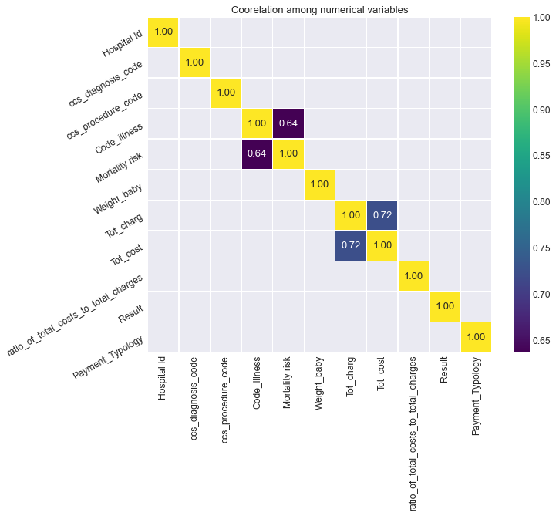
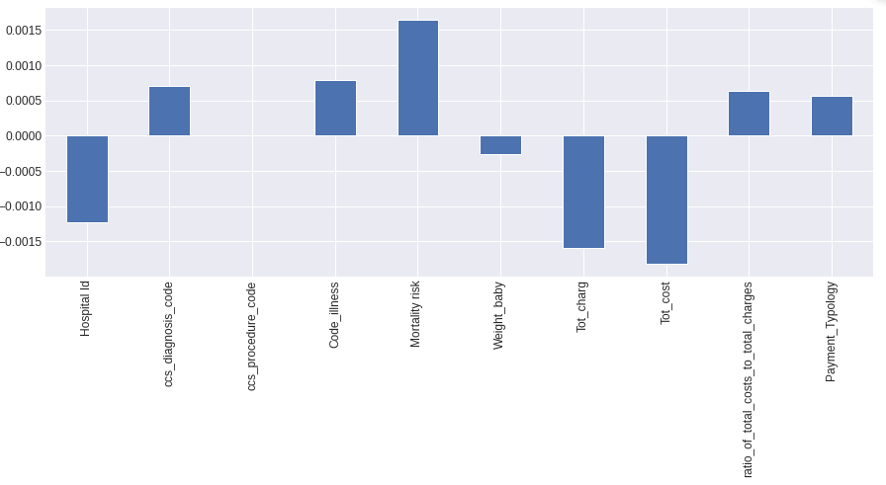
2) EDA (basics) Features correlations
2) Correlations with target variables
1) Feature to feature relationship

Slide 8
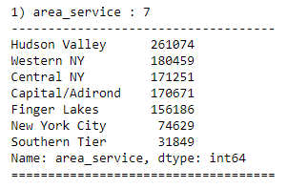
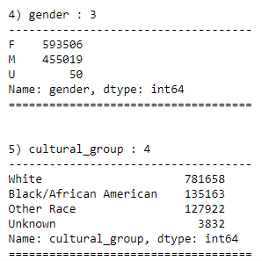
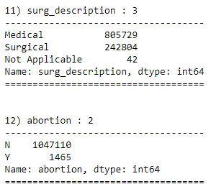
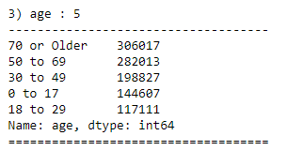
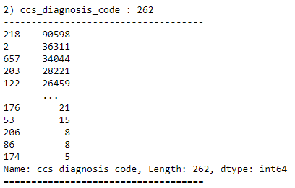
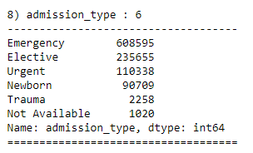
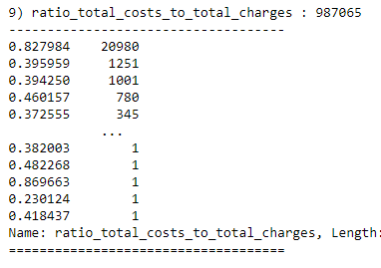
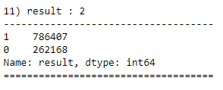
2) EDA (basics) Total counts with uniqueness

Slide 9
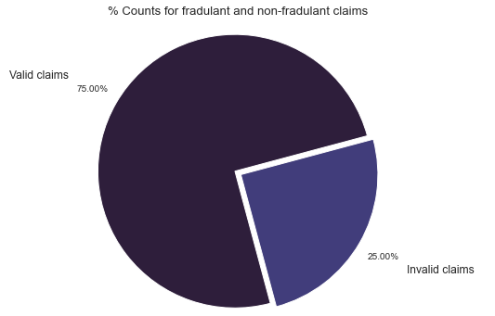
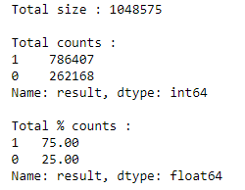
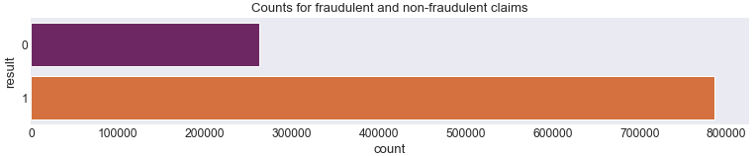
2) EDA (Univariate Analysis) Target feature
1) Result
Target variable have highly imbalance proportion of valid to fraud claims
Ratio of valid claims to fraud claims is about 75:25

Slide 10
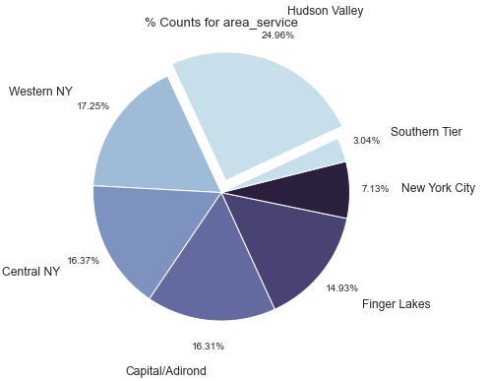
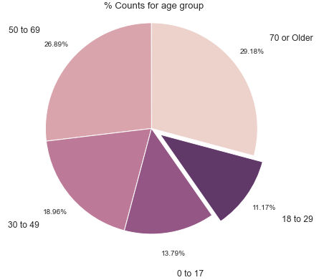
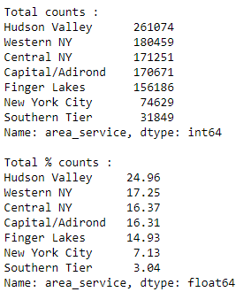
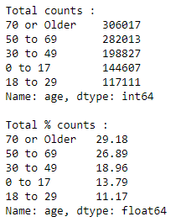
2) EDA (Univariate Analysis) Categorical features
2) area_service
3) age

Slide 11
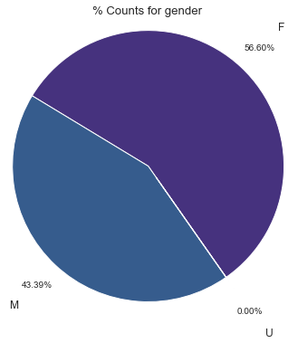
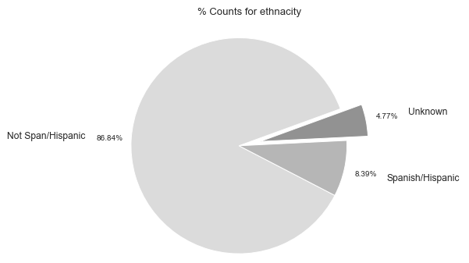
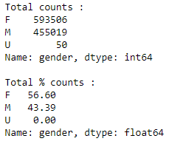
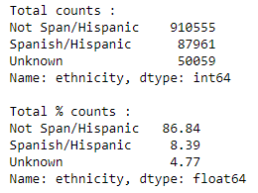
2) EDA (Univariate Analysis) Categorical features
4) Gender
5) Ethnicity

Slide 12
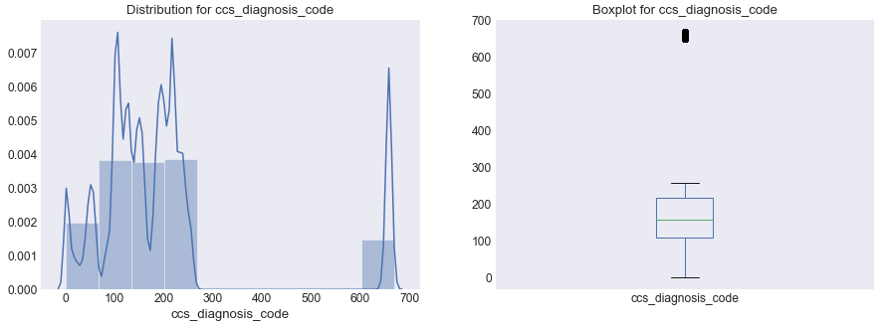
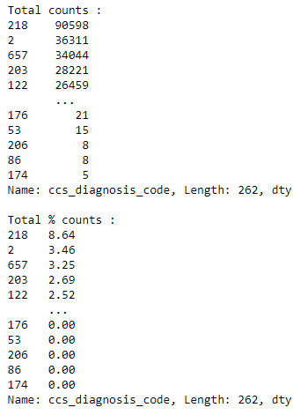
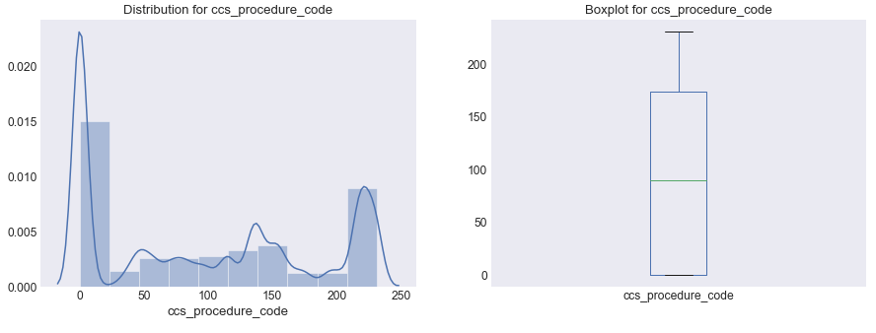
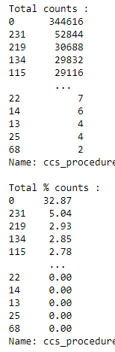
2) EDA (Univariate Analysis) Numeric features
6) ccs_diagnosis_code
7) ccs_procedure_code

Slide 13
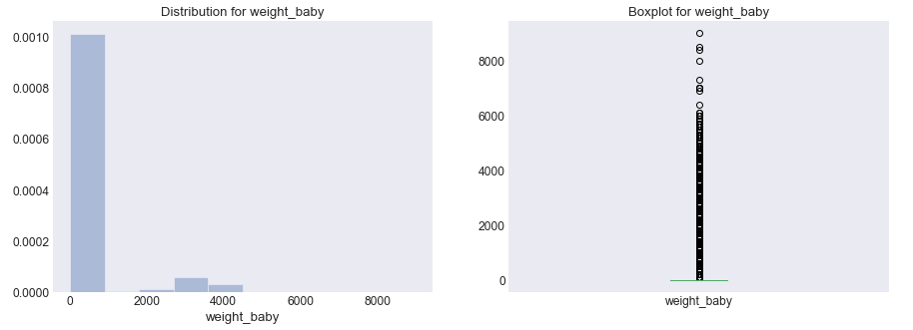
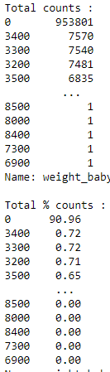
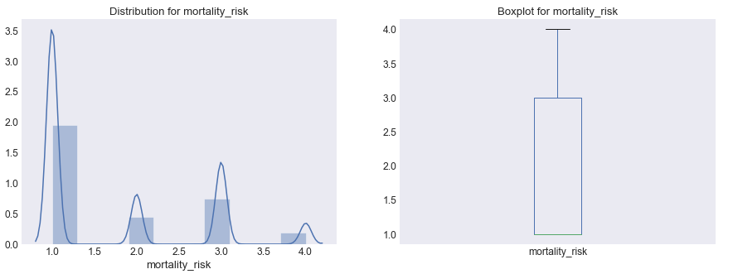
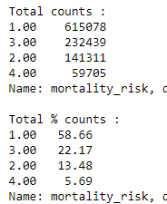
2) EDA (Univariate Analysis) Numeric features
8) weight_baby
9) mortality_risk

Slide 14
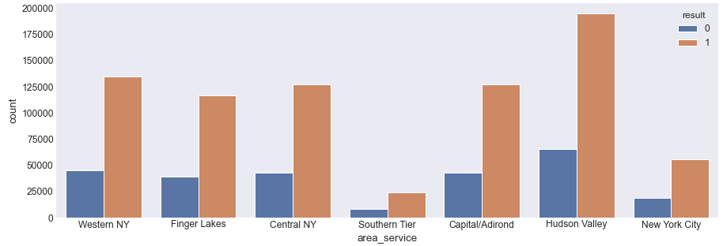
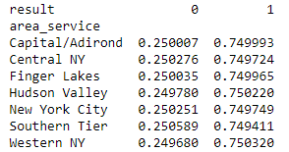
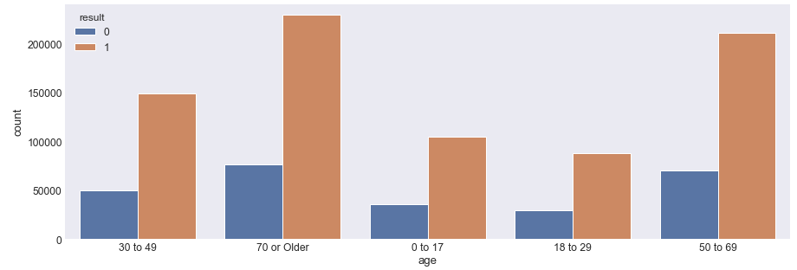
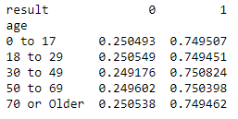
2) EDA (Bivariate Analysis) Categorical features
10) Relation between result and area_service
11) Relation between result and age group

Slide 15
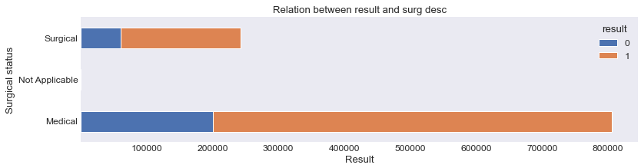

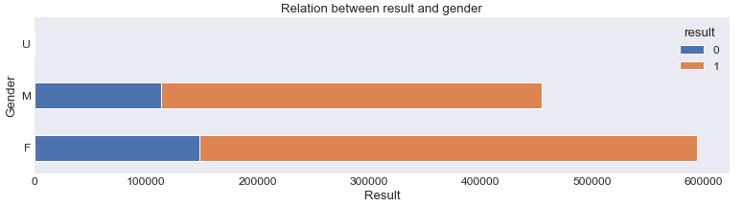

2) EDA (Bivariate Analysis) Categorical features
12) Relation between result and surg description
13) Relation between result and gender

Slide 16
3) Data Preprocessing and Findings
(Missing Values + Duplications + Skewness)
(Part I)

Slide 17
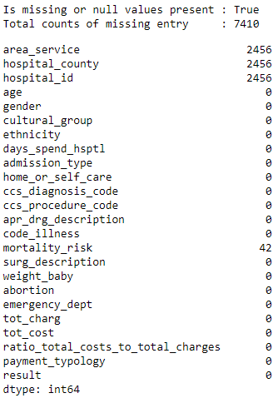
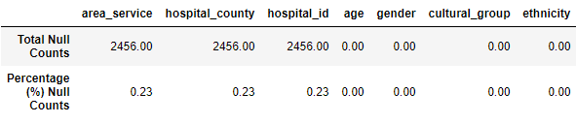
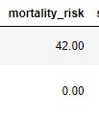
3) Data Preprocessing and Findings (Missing Values + Duplications)
1) Missing values findings
a) Is missing or any null values in our dataset ?
True
b) How many is total counts of the missing entries?
7410
c) In which feature, we have majority of the missing values?
area_service
hospital_id
hospital_county

Slide 18
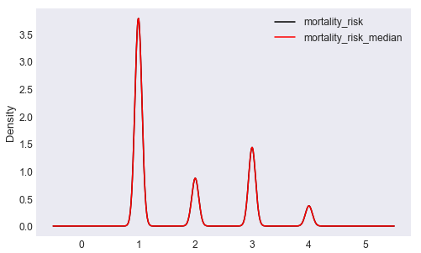
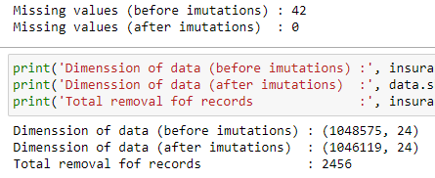
3) Data Preprocessing and Findings (Missing Values + Duplications)
2) Dealing with the missing values and imputation
a) For feature mortality_risk (median imputation technique)
The variance is not affected by the median imputation, hence we choose to fill missing values with median.
mortality_risk with median imputation
b) For features area_service + hospital_id + hospital_county (drop the features)

Slide 19

3) Data Preprocessing and Findings (Missing Values + Duplications)
2) Duplication records findings
Total duplication counts in data 4813
We have remove these duplications of records
After preprocessing, data dimension is (1041306, 24)

Slide 20
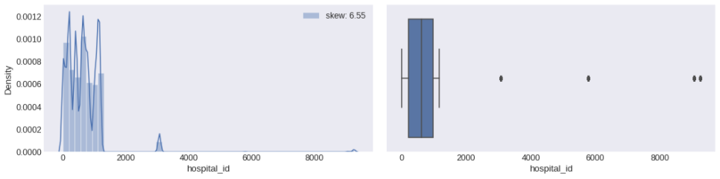
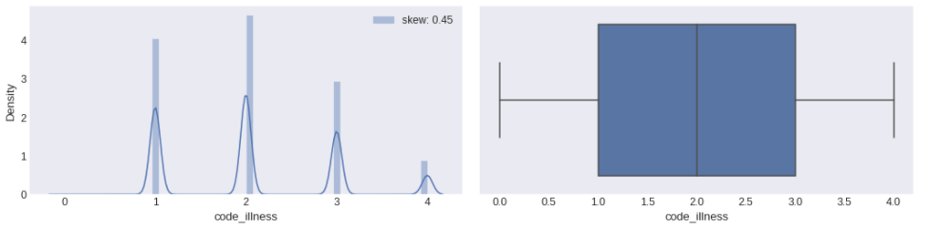
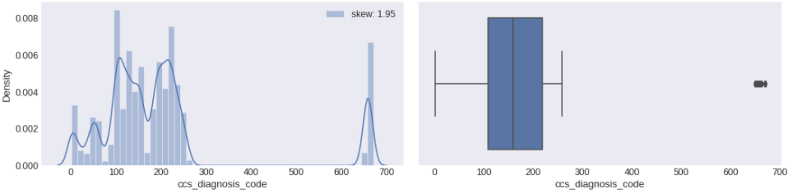
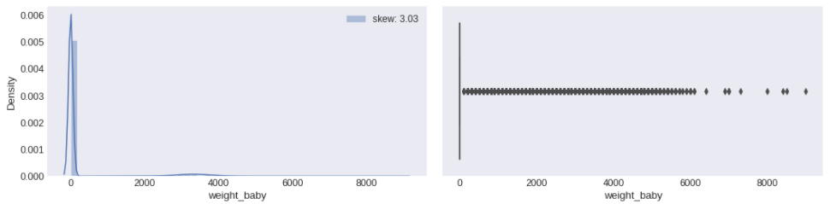
3) Data Preprocessing and Findings (Density + Skewness)
Skew: 6.55
Skew: 0.45
Skew: 0.45
Skew: 3.03

Slide 21
4) Features Engineering
(Features Encoding + Scaling + Selection)
(Part I)

Slide 22
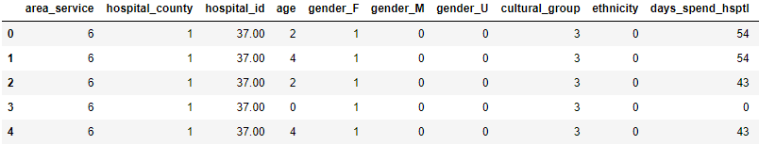
4) Feature Engineering (Feature encoding techniques)
We have apply two encoding techniques
Label Encoding Features
One-hot Encoding Features
area_service
hospital_county
age
ethnicity
cultural_group
days_spend_hsptl
admission_type
home or self care,
surg_desc
apr_drg_desc
gender
emergency_dept
abortion

Slide 23
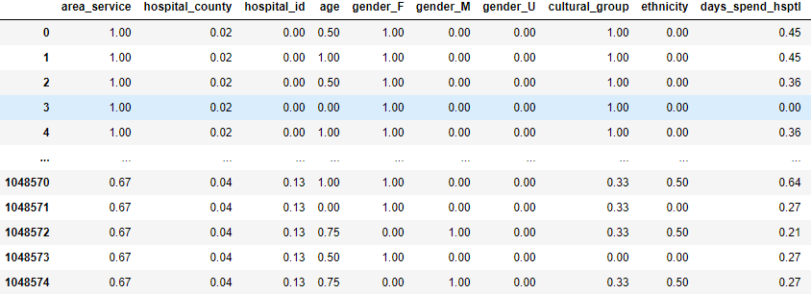
4) Feature Engineering (Feature scaling techniques)
We have tried with MinMaxScaler, StandardScaler and RobustScaler and found the best technique is
Below is the MinMaxScaler().
MinMaxScaler()

Slide 24
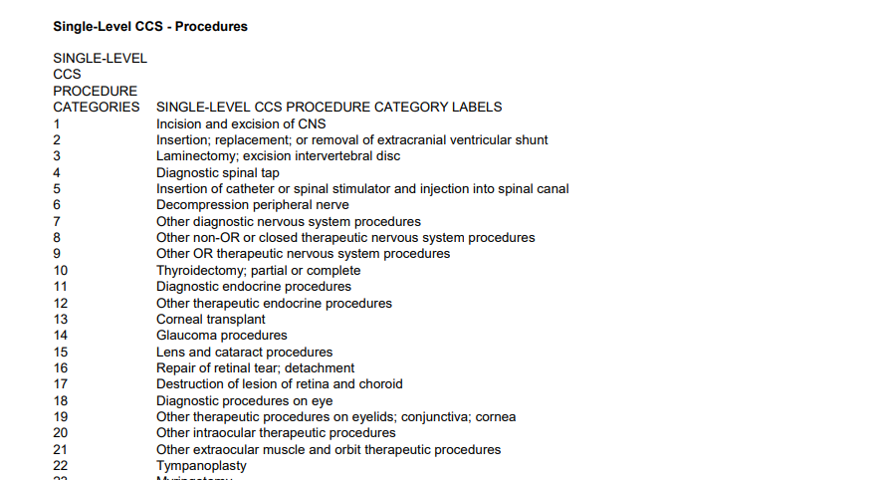
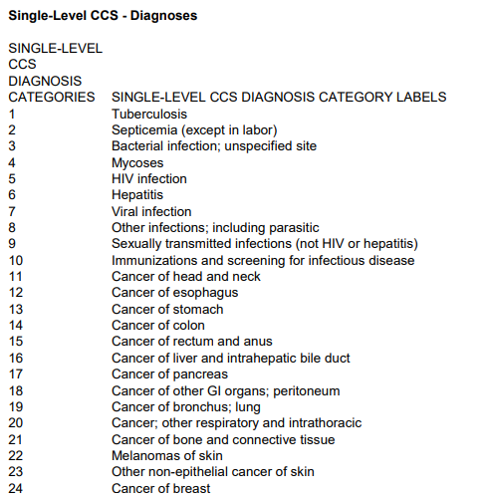
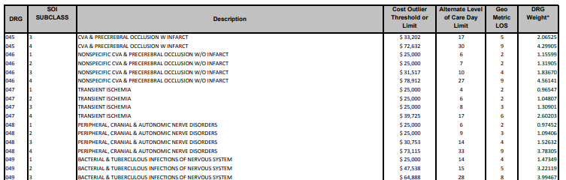
4) Feature Engineering (Survey and analysis)
css_procedure_code
css_diagnosis_code
apr_drug_description

Slide 25
4) Feature Engineering (Feature selection techniques)
1) Feature selection as per the business objective and insides in data, below are the points
Features area_service, hospital_county and hospital_id which are not significant with respect to the output variable "result“.
As features mortality_risk and code_illness having somewhat moderate correlation about (0.64) above the threshold, so that they are highly dependent with each others only. Hence removing one of the highly correlated feature mortality_risk.
Gender feature has unknown (gender_U) values which are less in counts with respect to the counts of Male and Female, So we removed it.
We have taken feature ratio_total_costs_to_total_charges as the ratio which is generally calculated by the two features tot_charg and tot_cost and hence we are going to remove these two features and accepting ratio of that.

Slide 26

4) Feature Engineering (Feature selection techniques)
1) Feature selection as per the business objective and insides in data, below are the points
The APR-DRG Classification Code Description specifies description categories about the diseases, illness, etc. We get the description from code illness group, hence we are removing the feature apr_drg_description.
Feature abortion has only 0 values and its lead towards low variance. Due to this low variance feature among all, so we are removing it.
From the survey, we are going to remove ccs_diagnosis_code as of multiple repetition of the codes and we are able to get this codes from feature code illness itself. ccs_procedure_code we are removing as it cannot be zero and from our case, the code starts from zero.

Slide 27


4) Feature Engineering (Feature selection techniques)
2) Feature selection by ML algorithm (RF + ET)
Below are the Top 13 features with their rank and importance's
Features by RF
Features by ET

Slide 28
5) Model Interpretations I
(Without Balancing techniques)

Slide 29

Classification results (Without Balancing…)

Slide 30
5) Model Interpretations II
(Balancing techniques after splitting the data)

Slide 31


Balancing techniques with the Classification results

Slide 32

Balancing techniques with the Classification results

Slide 33
6) EDA and Data Preprocessing
(Part II)
Why Results are not improving….? Why…?.....Why?

Slide 34

Boxplot of whole data w.r.t target feature is 0

Slide 35

Boxplot of whole data w.r.t target feature is 1

Slide 36
8) Model Interpretations III
(Data Balancing technique before train_test_split…)

Slide 37
Strategies Used to Solve this problem…
Balancing the data before train_test split.
2) Next step is to split data into train_test.
3) Estimator – Random Forest
4) n_estimators parameter should be set to 10-20
5) Model validation tech. – Stratified K-Fold

Slide 38
Concept: Dataset Balancing Before train test split

Slide 39

Code Discussion…

Slide 40


Why we have chosen less n_estimators…?

Slide 41




Classification results
Training set
Testing set
Unseen dataset

Slide 42


Complete dataset
Test_data

Slide 43

Model Validation…. Stratified K-fold

Slide 44

Stratified K-fold : F1 Score metrics

Slide 45
9) Model Deployment
( FLASK, Streamlit )

Slide 46

Model Deployment

Slide 47

Click on below page to view heroku app...

Slide 48
Thank You..!

